Slide 1
Chapter 7 Appendix
Objectives of this chapter is the following.
How to develop reports (EUR)
Notes:
www.mcframe.com
MCFrame Training
-<number>-
In this chapter, we’ll cover how to develop reports using EUR, and Smalltalk syntax.
Please use for your practice.
*EUR Professional Edition (report development environment) is required to develop EUR reports.

Slide 2
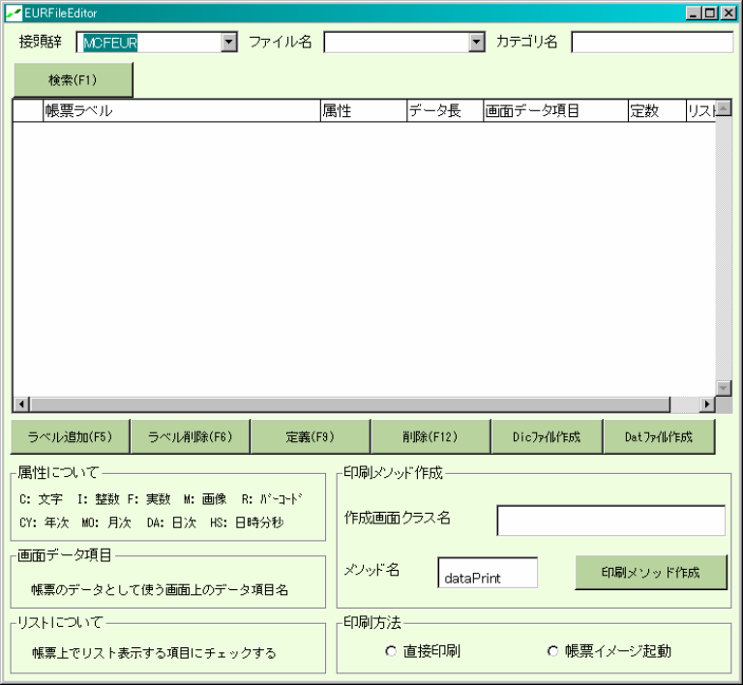
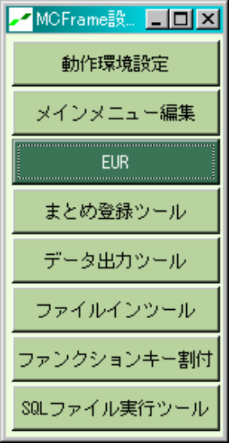
7-1. Report Development (EUR)
Report customization example
Function (Sub-Category) | Production Plan
Screen Name | Order Status Detail Screen
Class Name | COREOrderSyousai
EURFileEditor
MCF Setting
Notes:
www.mcframe.com
-<number>-
Functionality of report development tool:
Create a program (template program) to convert existing screen class data to comma delimited format.
Auto-create a dictionary file and a test data file to be used by EUR.
Template program has a functionality to execute EUR and read a comma delimited file.
Applications including Access and Excel which has a functionality to read a CSV file can be used instead of EUR.
In this example, report print button is added in Order Status Detail Screen and EUR report is produced using a report development tool.
Steps
1)
1. Verify correct paths are for the following folders in “Operation environment configuration“ screen.
Report form path in MCFrame install folder
Report program (EUR) program path (apgrpt.exe)
2. Verify correct folders are set for EURFMS, EURDIC, EURDAT in ja_JP folder under report form path.
3. Open “EURFileEditor” screen clicking “EUR” button.
MCFrame Training

Slide 3
7-1. Report Development (EUR)
EUR File
File Type (Extension) | Description
fms | This file stores Report Form information. (This file is created for each language)
dic | This file stores field attributes. Dictionary files aren’t required for versions EURVer4 and later. (Field attributes can be defined in fms file.)
dat | This file stores data file, and output data.
Notes:
www.mcframe.com
-<number>-
MCFrame Training

Slide 4
7-1. Report Development (EUR)
Configuration Items
Configuration Item | Description
Report Label | Header name
Attribute | Data type to display
Data Length | Data length to display
Screen Data Field | Variable or constant names in a list
Constant | Check when a constant value is used for a screen field data
List | Check when a screen data field is used as a variable name for the list
Report Configurations
Report Label | Attribute | Data Length | Screen Data Field | List
Hierarchy | C | 20 | HYR | Check
Item Code | C | 20 | ITM_CD | Check
Item Name | C | 40 | ITM_NM | Check
Order Type | C | 4 | ORD_TYP_NM | Check
Order Status | C | 10 | ORD_STS_TYP_NM | Check
Production Location Name | C | 20 | PROD_LOC_NM | Check
Inventory Location Name | C | 20 | STK_LOC_NM | Check
Lot Number | C | 15 | LOT_NO | Check
Production Start Plan Date | DA | 10 | PROD_ST_SCHD_DT | Check
Production Quantity | F | 9 | PROD_SCHD_QTY | Check
Notes:
www.mcframe.com
-<number>-
2) Enter an unique file name and click a button to add a label.
Enter the following values.
a) Enter “order” in a file name field.
b) Enter other fields as well, and check all the List fields.
MCFrame Training

Slide 5
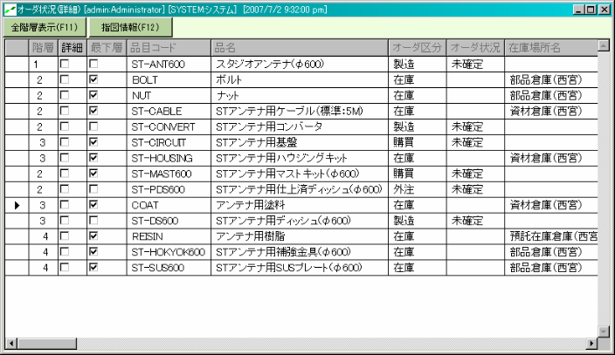
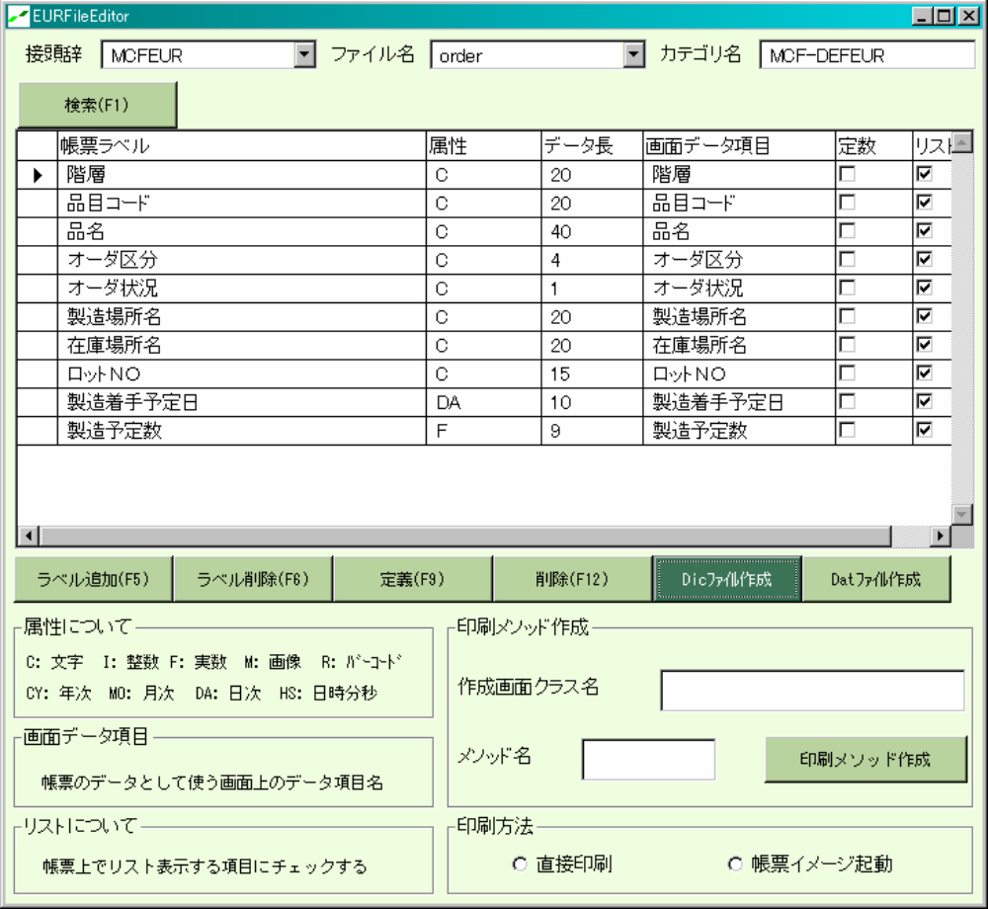
7-1. Report Development (EUR)
“Order Status Detail” screen
1. Enter “order” and click “Search” button.
This list will be output in a report.
2. Click “Add label” button,
and enter values.
3. Click “Definition” button,
click “Create dic file” button.
Notes:
www.mcframe.com
-<number>-
This is an example to setup Order Status Detail Screen dataset.
MCFrame Training

Slide 6
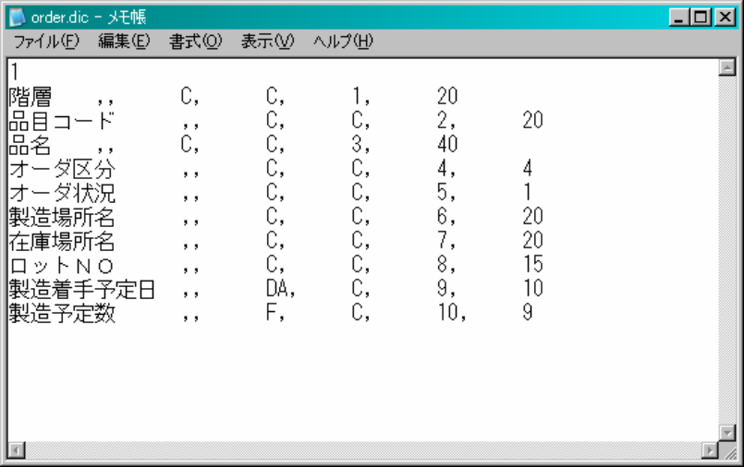
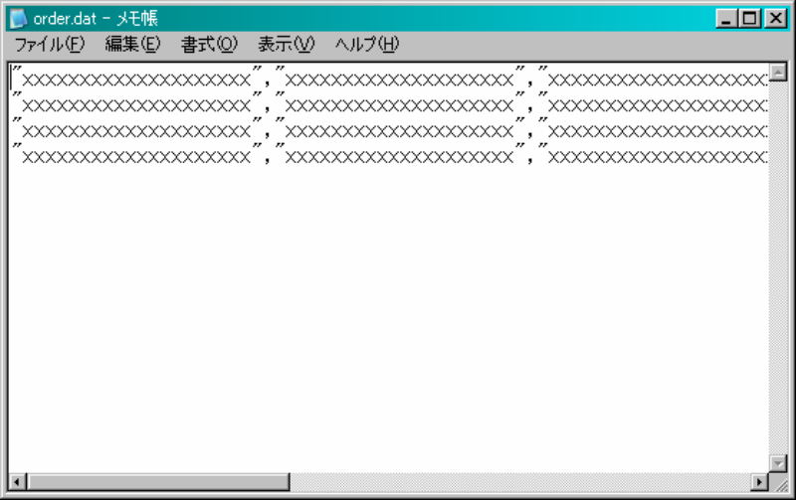
7-1. Report Development (EUR)
order.dic File Created
order.dat File Created
Notes:
www.mcframe.com
-<number>-
3) Click “Definition” button after all the fields are added.
“MCFEURorderRow” class will be created as a subclass of “MCFEURRow” class.
Then, create a dictionary definition file and a data file for EUR by clicking “Create dic file” button.
When the file creation is complete, the following text files will be created.
When “Create dat file” button is clicked, only data file will be created and displayed.
A dictionary file is created in EURDic folder set in “MCFSettingTool” class and a data file is created in EURDat folder.
In case of an error, please confirm those folder settings.
Dictionary file created will be used for EUR.
Data file created can be used as test data.
MCFrame Training

Slide 7
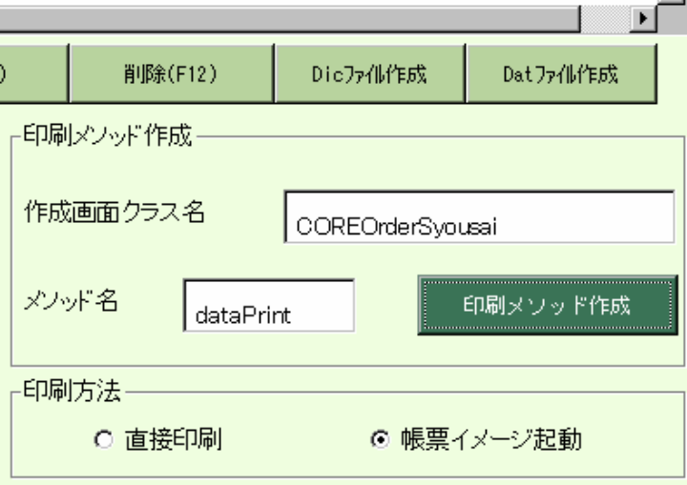
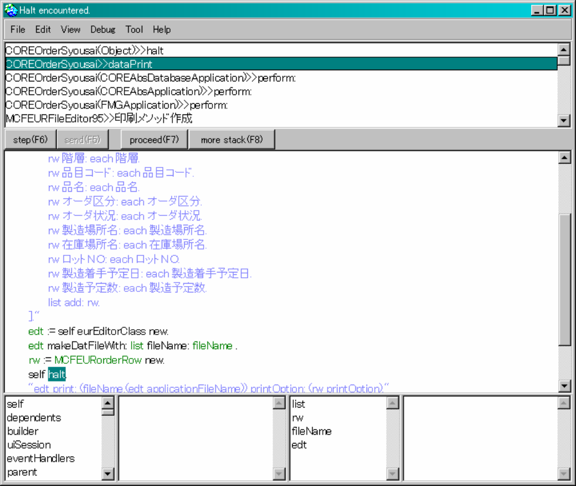
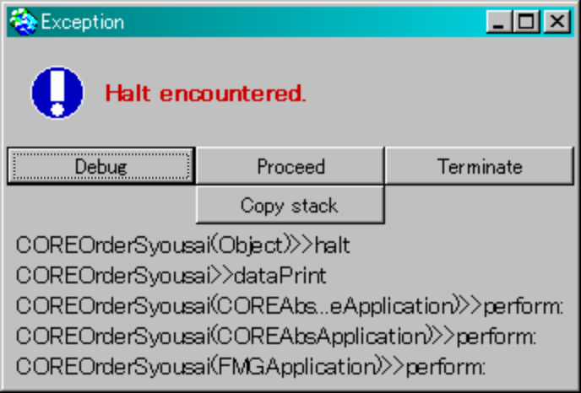
7-1. Report Development (EUR)
Notes:
www.mcframe.com
-<number>-
4) We’ll define a print method.
We’ll set a print program in a screen class.
a) Set “COREOrderSyousai” to the screen class name.
b) Set “dataPrint” to the method name.
c) Select “Start Report Image” for the print method.
d) Click “Create print method” button, and click “Yes” when it prompts for re-defining the button.
e) Click the debug button in “Halt encountered.” after the completion message is displayed, and select “dataPrint” (2nd from the top) from the list.
MCFrame Training

Slide 8
7-1. Report Development (EUR)
dataPrint Method Created
dataPrint
| list rw fileName edt |
list := List new.
fileName := 'order'.
"rowsList list do:[:each|
rw := MCFEURorderRow new.
rw Hierarchy: each Hierarchy.
rw Item Code: each Item Code.
rw Item Name: each Item Name.
rw Order Type: each Order Type.
rw Order Status: each Order Status.
rw Plant Location Name: each Plant Location Name.
rw Stock Place Name: each Stock Place Name.
rw Lot Number: each Lot Number.
rw Production Start Plan Date: each Production Start Plan Date.
rw Production Prescribed Number: each Production Prescribed Number.
list add: rw.
]."
edt := self eurEditorClass new.
edt makeDatFileWith: list fileName: fileName .
rw := MCFEURorderRow new.
self halt.
"edt print: (fileName,(edt applicationFileName)) printOption: (rw printOption)."
"edt printEdit: (fileName,(edt applicationFileName))" “If you want to modify, Do it the left row."
Notes:
www.mcframe.com
-<number>-
f) Remove the quotations of enclosed “dataPrint” method area in red, and accept.
MCFrame Training

Slide 9
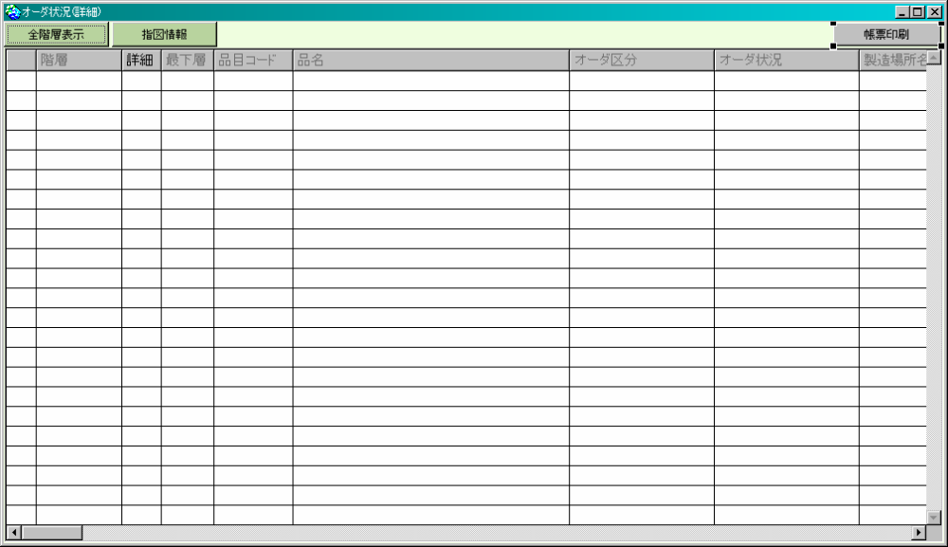
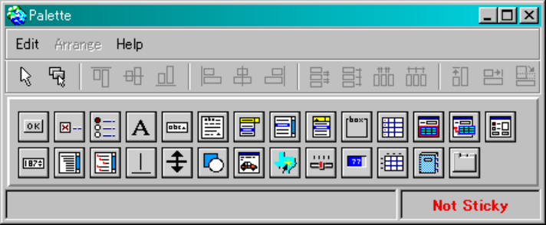
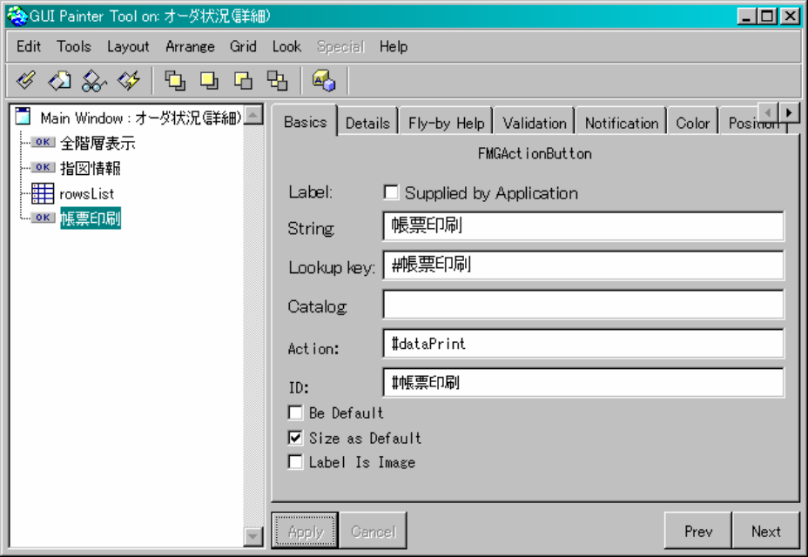
7-1. Report Development (EUR)
Notes:
www.mcframe.com
-<number>-
5) We’ll add a “Report print” button.
a) Open “Order status” screen for Production Plan from MCFrame menu.
Search, select records, and click order detail button to Open “Order Status Detail” screen.
Ctrl and right-click on a screen, and select Canvas.
Or open Browser for “COREOrderSyousai” class, open Canvas right-clicking Canvas on Browser, and open Palette right-clicking on Canvas.
b) Add to the screen by selecting an action button (FMGActionButton) from Palette.
Select the action button added, right-click and select PainterTool
c) Once Property Window appears, enter appropriate values for String, Action and ID, and click Apply button.
Button label becomes Print Report, and clicking the button will execute the method defined in Action (“dataPrint” method defined previously).
d) Right-click on Canvas and select “Install …” to perform the installation. Then, click OK in the next dialog.
e) Close Property Window and the Canvas screen.
f) Open “Order Status Detail” screen from the MCFrame menu, search and select appropriate records, and click the “Order Detail” button to open “Order Status Detail” screen.
Select “Order details” and click “Print report” button added.
Select “Debug” when “halt encountered” dialog appears.
Remove self halt. in the “dataPrint” method, and Accept.
MCFrame Training

Slide 10
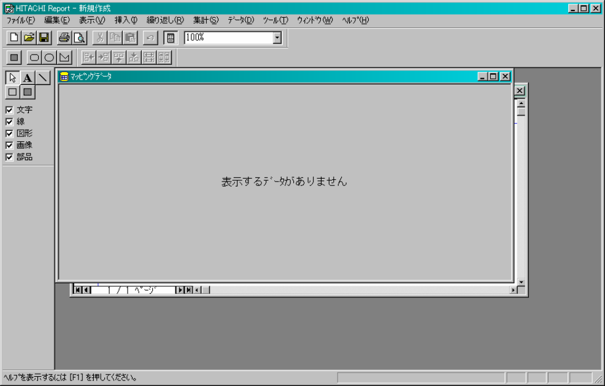
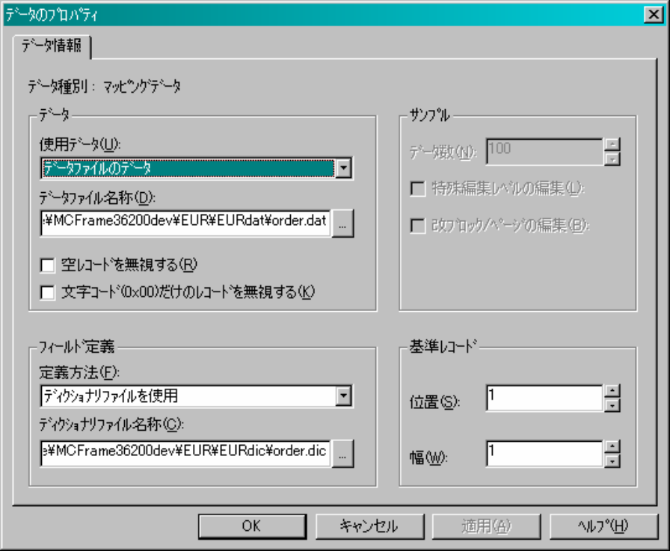
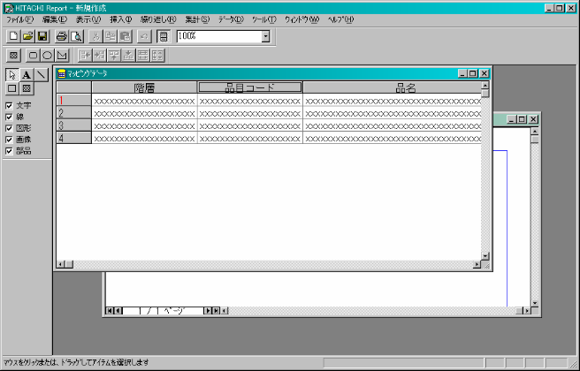
7-1. Report Development (EUR)
ＥＵＲ
Right-Click and
select “Data properties”.
Select dat file created.
Select dic file created.
Mapping is completed
Notes:
www.mcframe.com
-<number>-
6) We’ll create a report form.
a) Start EUR from Windows menu.
Once EUR starts, Form Sheet Window (Report Window) and Mapping Data Window will appear.
Select Mapping Data Window.
b) Right-click Mapping Data Window, and select data properties.
Enter the following values and click OK.
Data:
Data Source: Data in data file
Data File Name: Full path of dat file created
Field Definition:
Definition: Use dictionary file
Dictionary File Name: Full path of dic file created
MCFrame Training

Slide 11
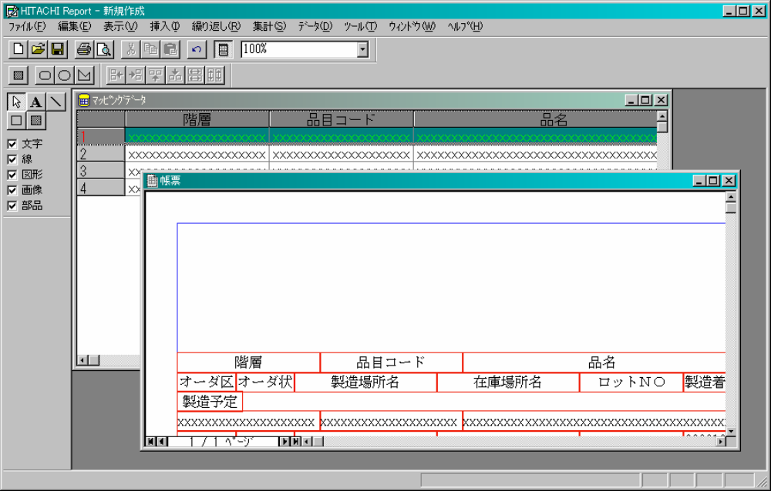
7-1. Report Development (EUR)
Select field name (label) and 1st record
When the cursor turns into
Drag-drop into Report Window.
Notes:
www.mcframe.com
-<number>-
c) Left-click and select a field name and a left hand side of a record in Mapping Data Window.
Now borders around the field name and the record appear and they become selectable.
Cursor will change to a plus sign when it’s moved.
Move to Form Sheet Window while pressing left-mouse-button, and release the mouse button.
Data will be pasted now.
(Please set page style to landscape in advance.)
MCFrame Training

Slide 12
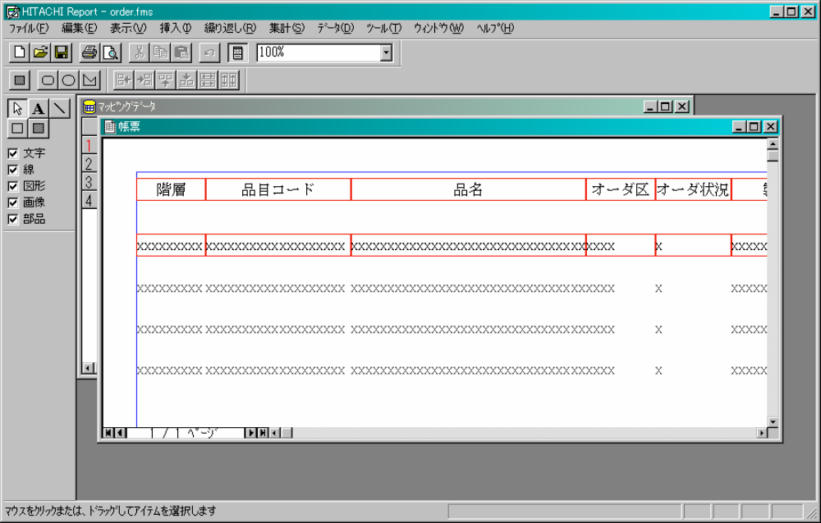
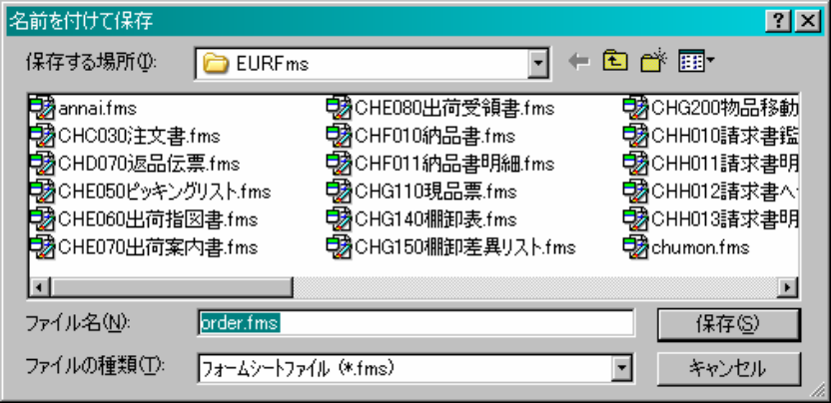
7-1. Report Development (EUR)
EUR with Repeat
Form File (fms) Save
Notes:
www.mcframe.com
-<number>-
d) Select all the data items on Form Sheet Window.
Rubber band will appear as they are dragged.
All the items in rubber band are selected.
(Rubber band are the borders of selected data field in Data Window and Form Sheet Window.)
e) Menu Bar – Repeat – Repeat specified
f) Menu bar – Repeat – Vertical Alignment – Setting – Setup repeat position on the screen.
Cursor becomes a plus sign.
Left-click the mouse button (rubber band appears) and move the rubber band to the repeating position.
Release the mouse button, and selected items will be repeated.
g) Menu bar – File – Save As
Move to (Report File path specified)\EURFms
Change the file type to Form Sheet File and save as “order.fms”.
MCFrame Training

Slide 13
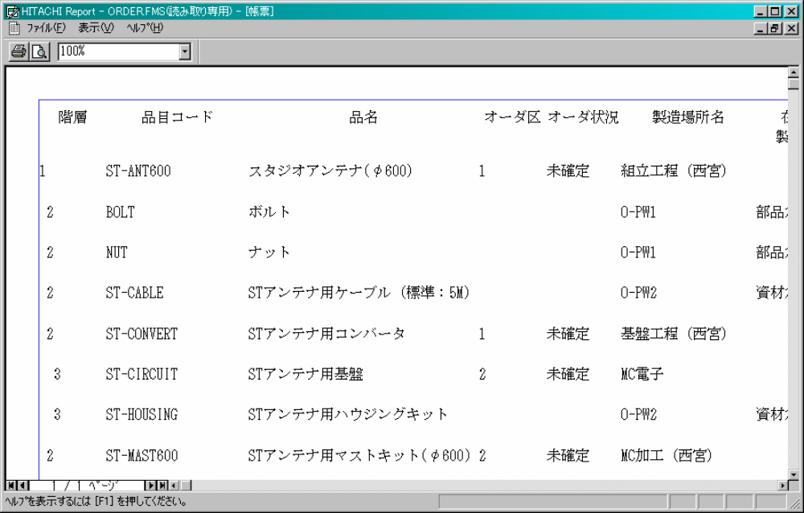
7-1. Report Development (EUR)
Open the Report Created
Notes:
www.mcframe.com
-<number>-
7) Open the report.
Open Order Status Detail Screen from the main menu and display some records.
Click Report Print button. order.fms will be displayed as a report.
Note:
When we created the report, we used EUR path configured in “MCFSettingTool”.
Please make sure the path is correct.
Normally, language folders and their sub-folders are created in \eur at MCFrame installation.
EURFms … Layout file path
EURDic … Dictionary file path
EURDat … Data file path
MCFrame Training

